Slide 1
Web Scraping to gain company Insights
By: Alejandro Thompson Oporto
This analysis was performed using data provided by the British Airways Data Science virtual experience program provided by Forage.
Task: Scrape and analyze customer review data to uncover findings for British Airways

Slide 2
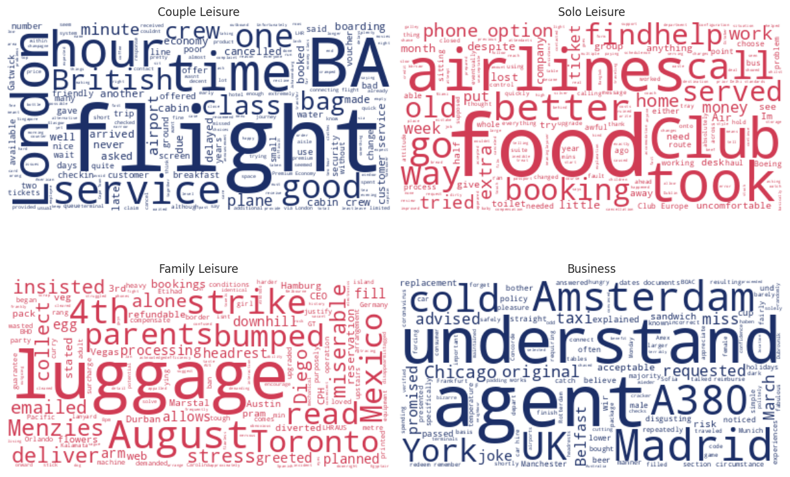
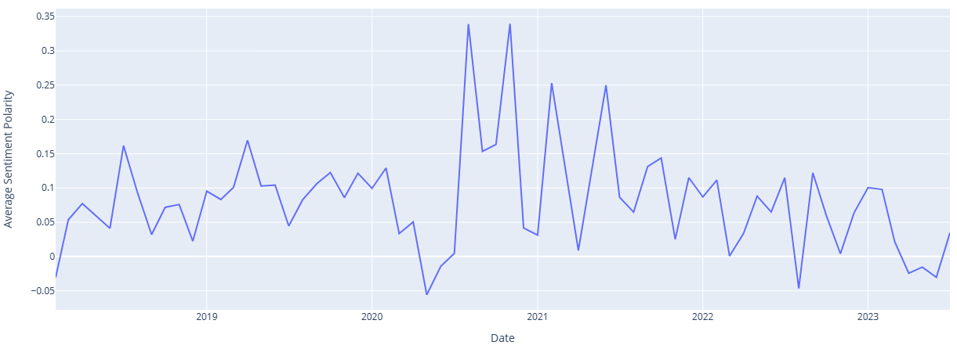
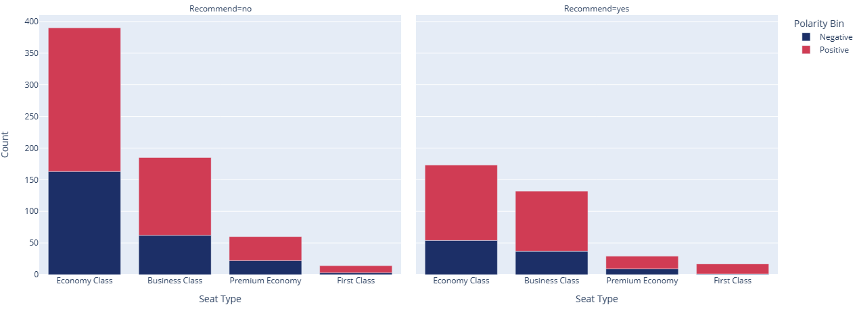
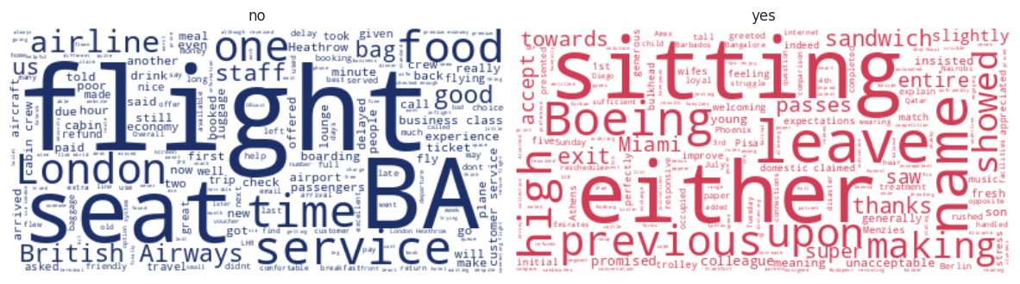
What are the words that appear most frequently by type of traveler?
How have the reviews evolved over the last few years?
What are the types of seats that have positive and negative travel reviews?
Do they recommend the service?
What are the most frequent words by type of recommendation?

